Slide 1
Optimal allocation of Funding/Resources among the NYC Hospitals during COVID 19 Pandemic

Slide 2
INTRODUCTION
COVID-19 is an infectious disease caused by the most recently discovered corona virus.
COUNTRY | CASES | DEATHS
United states | 5,874,146 | 180,604
Brazil | 3,605,783 | 114,772
India | 3,106,348 | 57,692
Russia | 956,749 | 16,383
South Africa | 609,773 | 13,059
New York City, which was once the epicenter of the pandemic in the US, has reported a total of 236,822 cases and 23,658 confirmed deaths (Source: The New York Times-Aug 23, 2020).

Slide 3
Business Problem
In this project I am going to analyse COVID-19 situation in NYC. Number of cases in each neighbourhood along with hospitals located in the neighbourhood will be used to analyse which hospitals possibly have higher need for resources/funding.
Target Audience
Governmental and non-governmental organizations, non-profits and charity
organizations, any volunteer willing to help by donating resources or time.

Slide 4
DATA COLLECTION
NYC COVID-19 data set - CSV file was downloaded from https://www1.nyc.gov/site/doh/covid/covid-19-data.page.
NYC data set - using neighborhood names from Covid-19 dataset, latitudes
and longitudes for each neighborhood were extracted using geocoder.
NYC Hospitals - Hospitals in each neighborhood are fetched from foursquare API

Slide 5
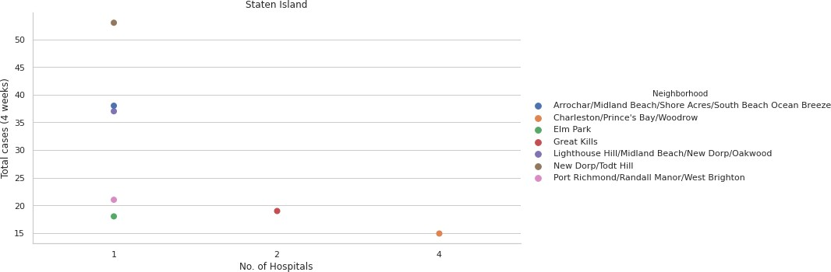
Exploratory Data Analysis
BOROUGH – STATEN ISLAND

Slide 6
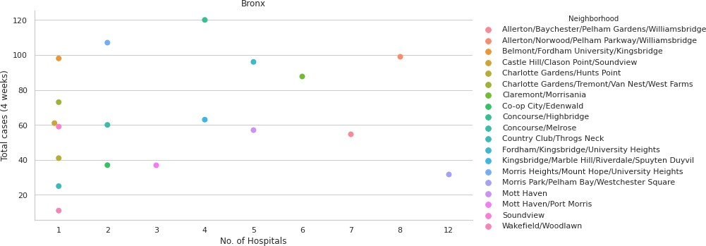
BOROUGH - BRONX

Slide 7
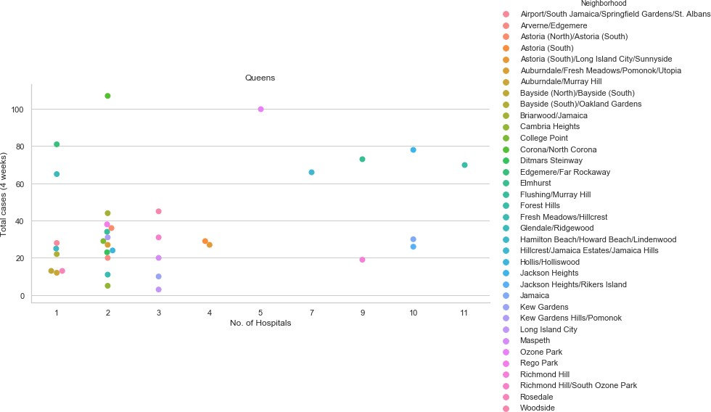
BOROUGH - QUEENS

Slide 8
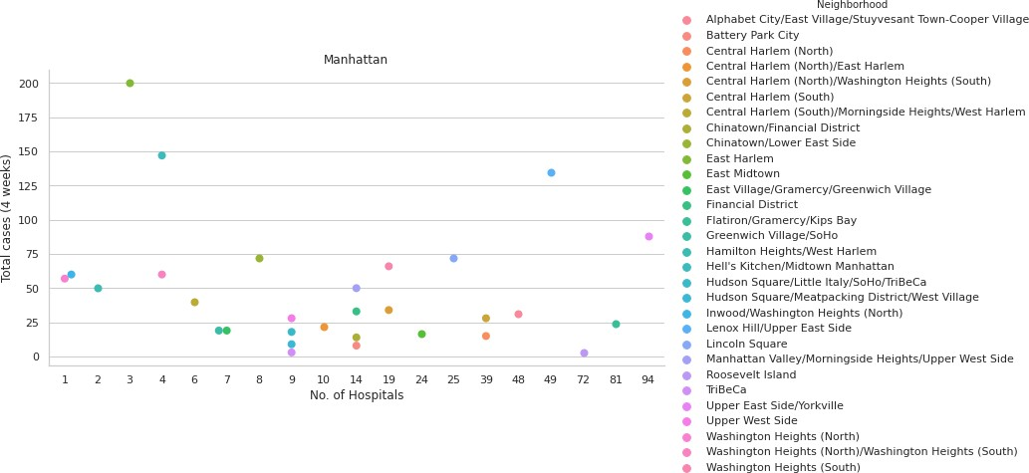
BOROUGH – MANHATTAN

Slide 9
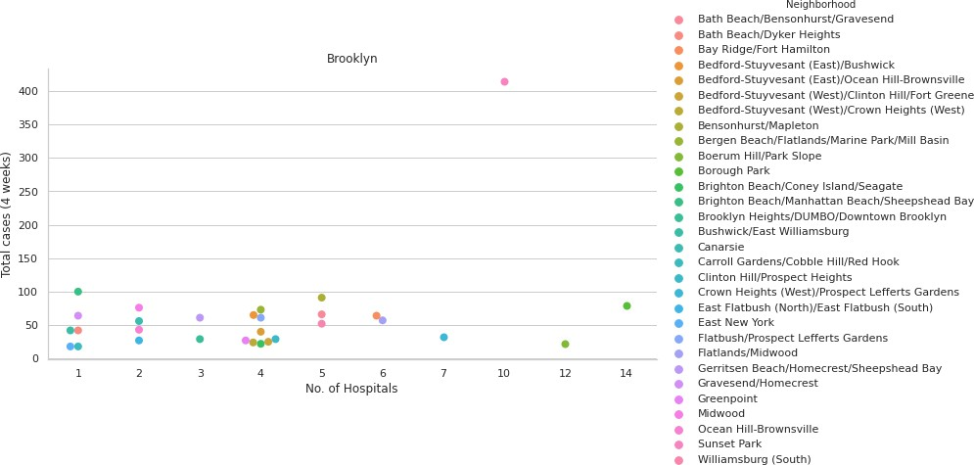
BOROUGH – BROOKLYN

Slide 10
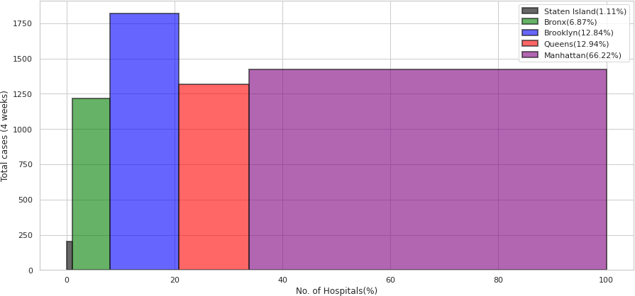
Graph depicting status of hospital availability vis a vis covid 19 cases & need assessment of resources (Borough Wise)

Slide 11
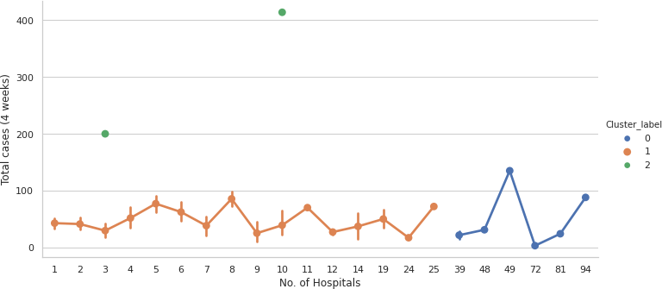
RESULTS
The point plot represents the 3 clusters formed using KMeans. Outliers in the dataset are marked by green points. These are the neighborhoods which have lower number of hospitals and higher number of cases.

Slide 12
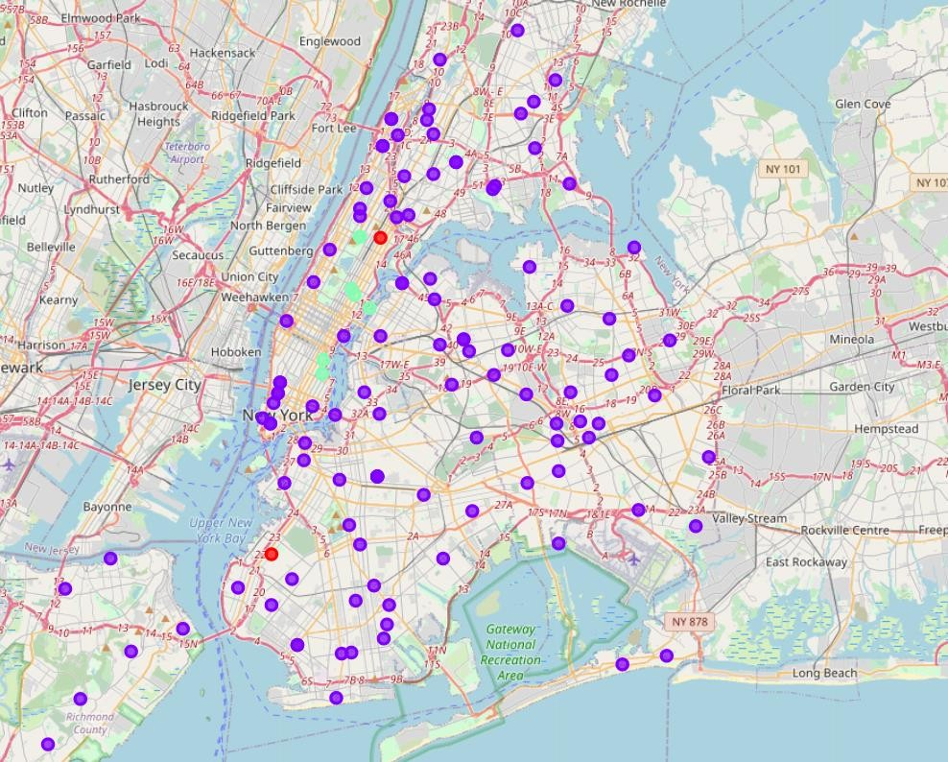



VISUALIZATION OF CLUSTERS ON NYC MAP
CLUSTER LABEL
cluster 2
cluster 1
cluster 0
-

Slide 13
CONCLUSION
Cluster 2 comprises of the following hospitals which require donation of resources or funding due to high number of Covid-19 cases in their respective neighbourhoods
NEIGHBOURHOOD | BOROUGH | HOSPITAL
East Harlem | Manhattan | General Hospital
East Harlem | Manhattan | VA Harlem Veterans Centre
East Harlem | Manhattan | New York City Health and Hospitals Corporation
Sunset Park | Brooklyn | CityMD Sunset Park Urgent Care
Sunset Park | Brooklyn | ModernMD Urgent Care
Sunset Park | Brooklyn | New York Centre for Special Surgery
Sunset Park | Brooklyn | NYU Lutheran Medical Centre
Sunset Park | Brooklyn | NYU Lutheran SICU
Sunset Park | Brooklyn | LMC 5th FLR
Sunset Park | Brooklyn | Calvary Hospital
Sunset Park | Brooklyn | NYU Lutheran Annex
Sunset Park | Brooklyn | NYU Langone Hospital
Sunset Park | Brooklyn | Maimonides Medical Centre

Slide 14
FUTURE PROSPECTIVES
Area wise hospitals specifically designated as covid centres can be considered.
Number of beds, ICU in each hospital can be used to determine which hospitals are in need for funding or resources.
Not all covid positive patients require hospital facilities. Factors like :
Age of patients
Underlying medical conditions of patients
Population of an area
influence requirement of resources for a particular hospital. Such factors can be taken into
consideration for future study in the domain area.
Number of clinical and non-clinical staff available in each hospital can also be taken into account.

